Slide 1

Applied Project Management
Nguyen Van Vien
Email: viennv@ueh.edu.vn
Mobile: 0973.225.589

Slide 2
An overview of project management
Project Management Institute (PMI) defines a project as “a temporary endeavor undertaken to create a unique product, service, or result” (PMBOK® Guide, PMI, 2021, p. 245).
“A project is a problem scheduled for solution.” - Dr. J. M. Juran
Source: Heagney (2022)

Slide 3
What Is Project Management?
“Project management is the application of knowledge, skills, tools, and techniques to project activities to meet the project requirements.” - PMBOK® Guide
Source: Heagney (2022)

Slide 4
Driving forces
Capital projects
Customer expectations
Competitiveness
Executive understanding
New project development
Efficiency and effectiveness
The need for business growth
Source: Kerzner (2017)

Slide 5
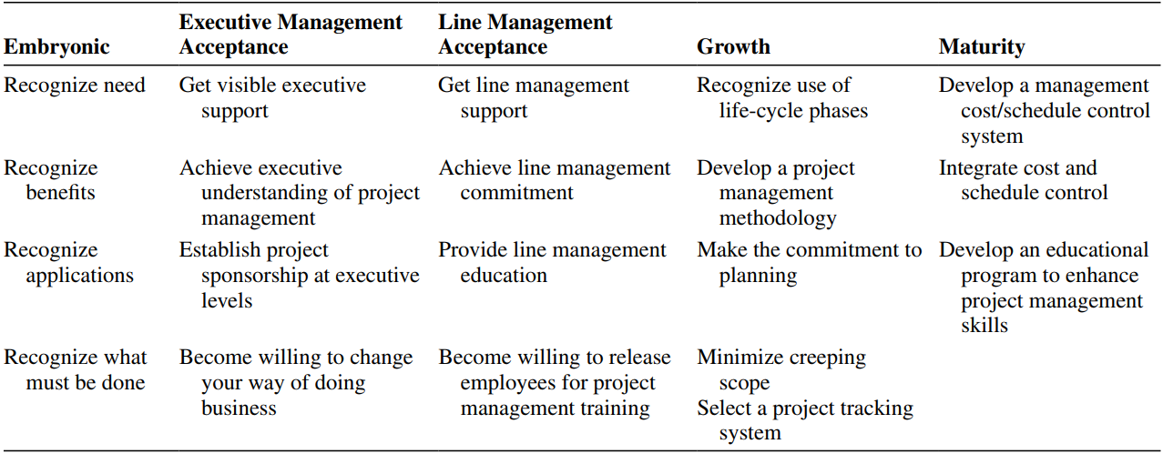
Five phases of the project management life cycle
Source: Kerzner (2024)

Slide 6
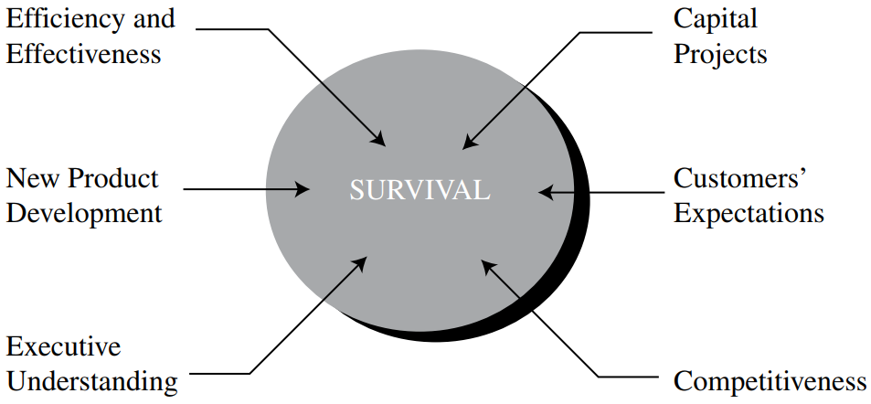
The components of survival
Source: Kerzner (2024)

Slide 7
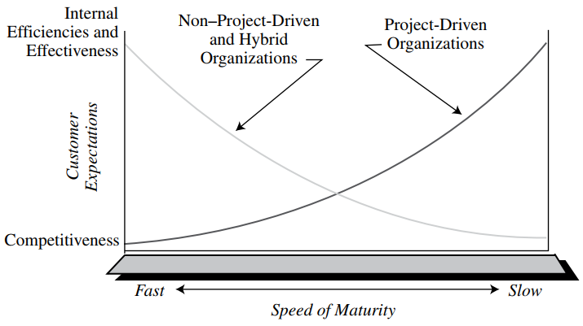
Speed of maturity
Source: Kerzner (2024)

Slide 8
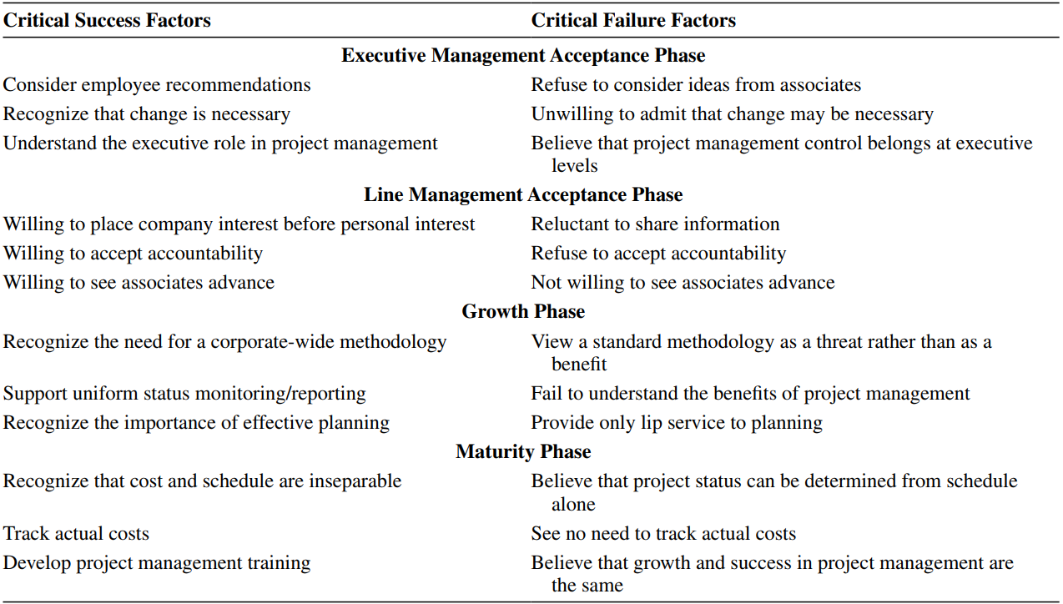
Critical factors in the project management life cycle
Source: Kerzner (2024)

Slide 9
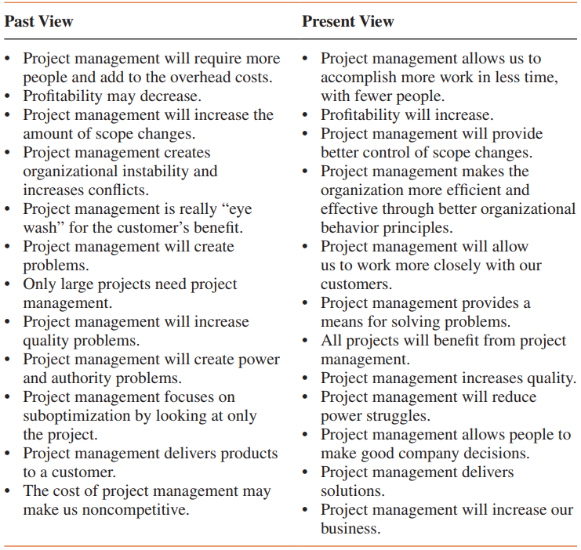
Benefits of project management
Source: Kerzner (2017)

Slide 10
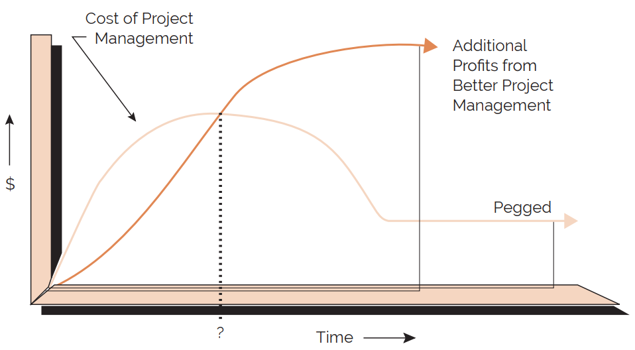
Project management costs versus benefits
Source: Kerzner (2017)

Slide 11
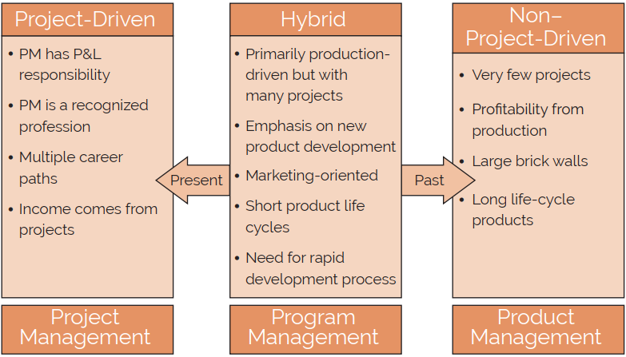
Industry classification (by project management utilization)
Source: Kerzner (2017)

Slide 12
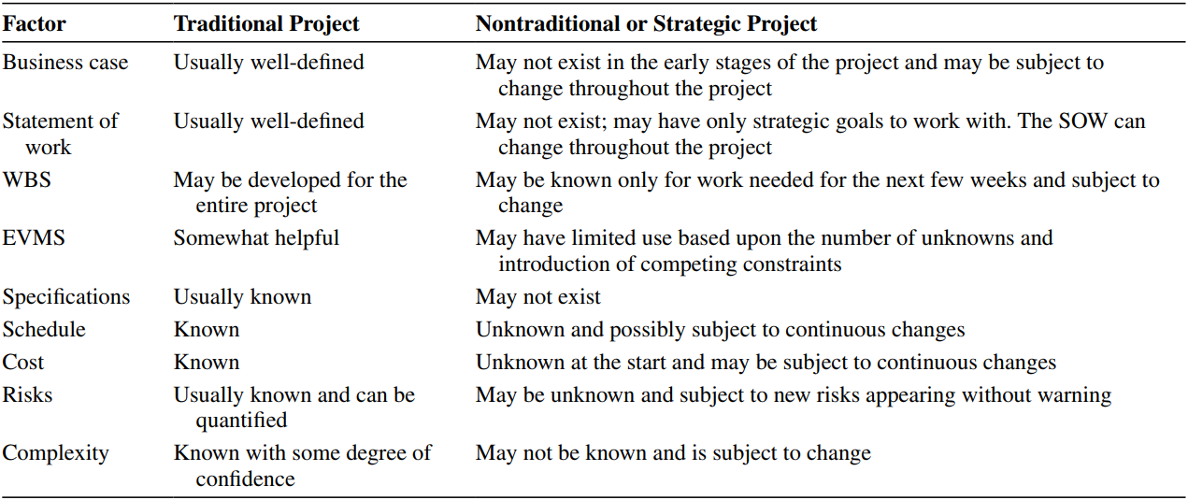
Differences between traditional and nontraditional projects
Source: Kerzner (2024)

Slide 13
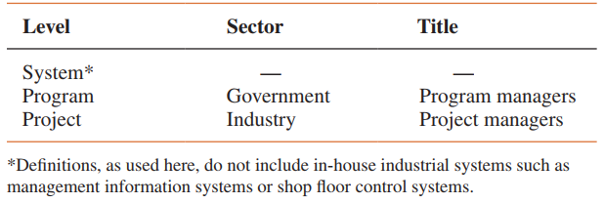
Systems, programs, and projects: a definition
Source: Kerzner (2017)

Slide 14
Product versus project management: a definition
There is also a difference between project and product scope:
Project scope defines the work that must be accomplished to produce a deliverable with specified features or functions. The deliverable can be a product, service, or other result.
Product scope defines the features or functions that characterize the deliverable.
Source: Kerzner (2017)

Slide 15
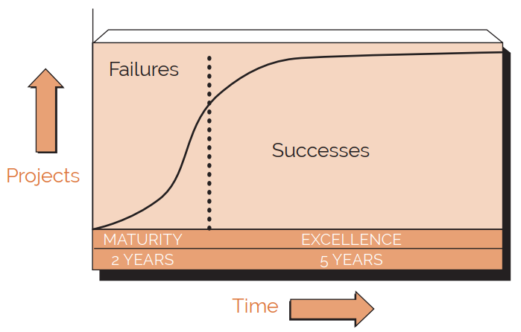
Maturity and excellence: a definition
Source: Kerzner (2017)

Slide 16
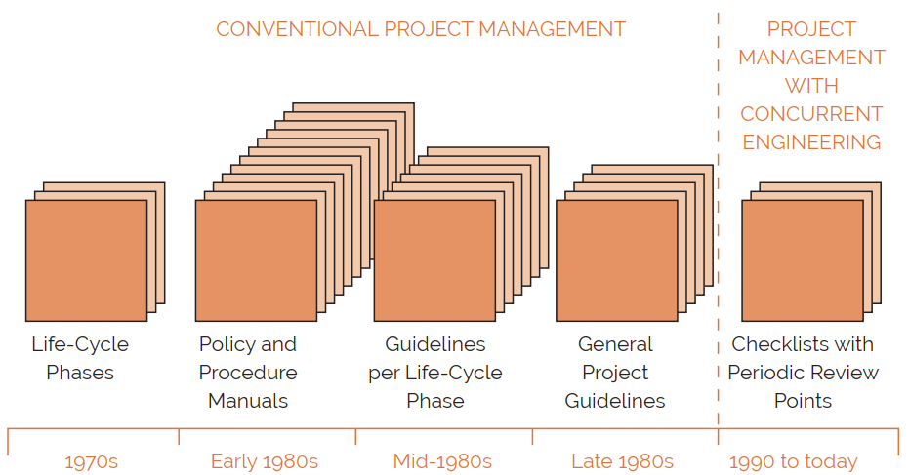
Informal project management: a definition
Source: Kerzner (2017)

Slide 17
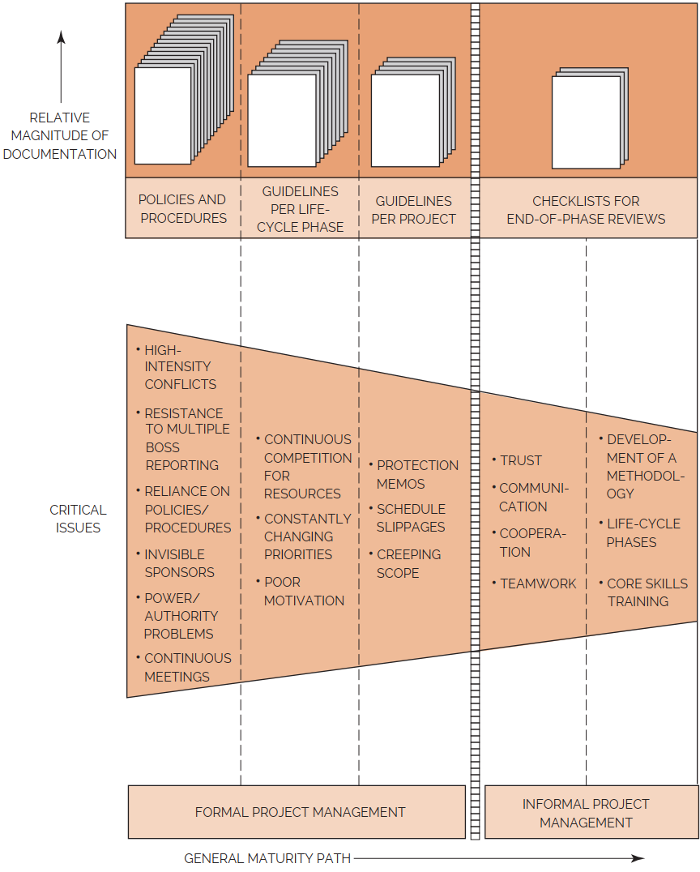
Maturity path
Source: Kerzner (2017)

Slide 18
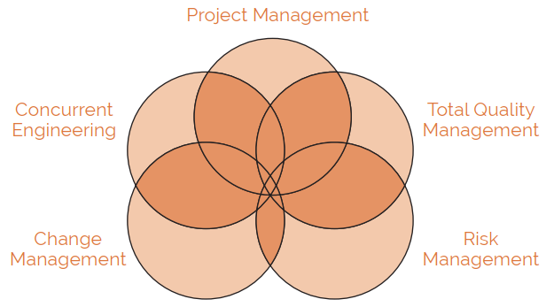
Project management methodologies: a definition
Source: Kerzner (2017)

Slide 19
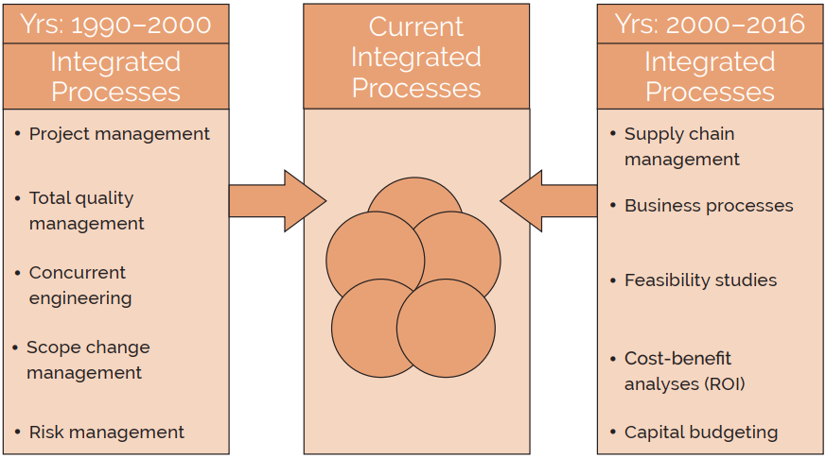
Integrated processes (past, present, and future)
Source: Kerzner (2017)

Slide 20
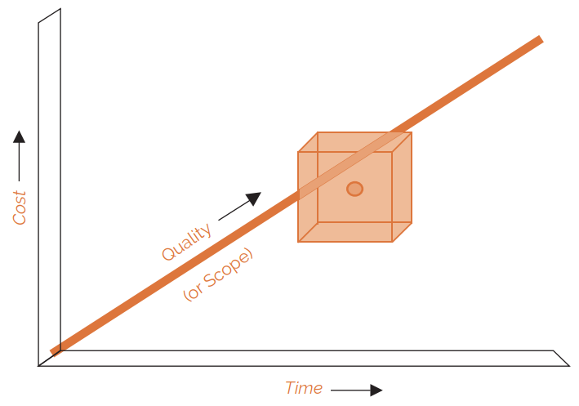
The many faces of success
Source: Kerzner (2017)

Slide 21
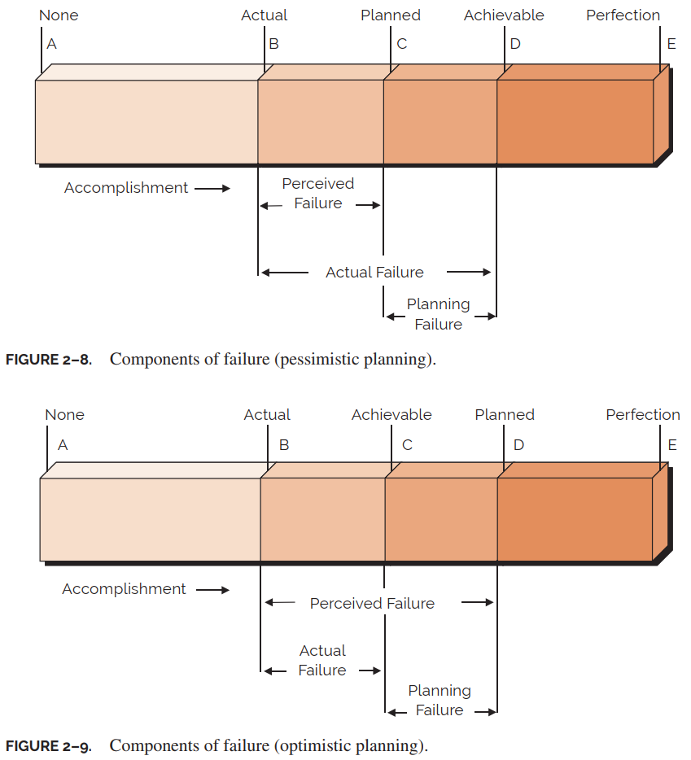
The many faces of failure
Source: Kerzner (2017)

Slide 22
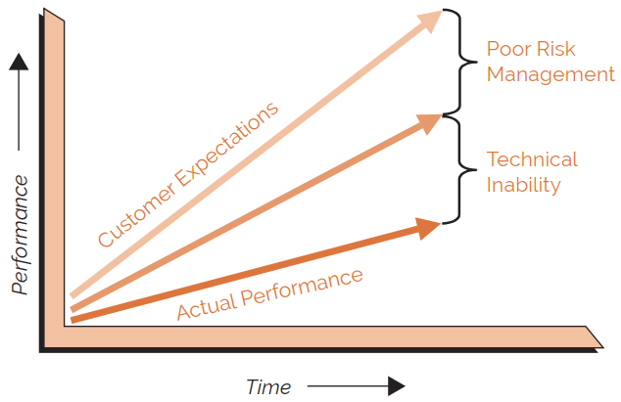
Risk planning
Source: Kerzner (2017)

Slide 23
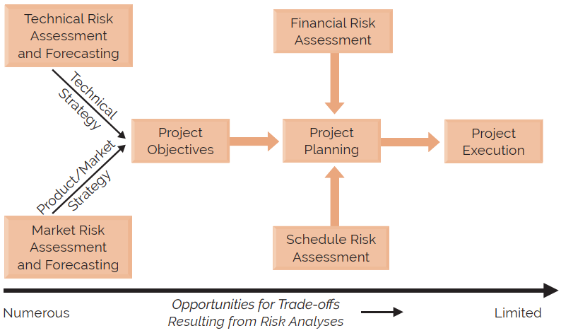
The relationship between marketing and technical personnel
Source: Kerzner (2017)

Slide 24
Project life cycles
Research and development
Market introduction
Growth
Maturity
Deterioration
Death
Source: Kerzner (2017)

Slide 25
The theoretical definitions of the life-cycle phases of a system
Conceptual
Planning
Testing
Implementation
Closure
Source: Kerzner (2017)

Slide 26
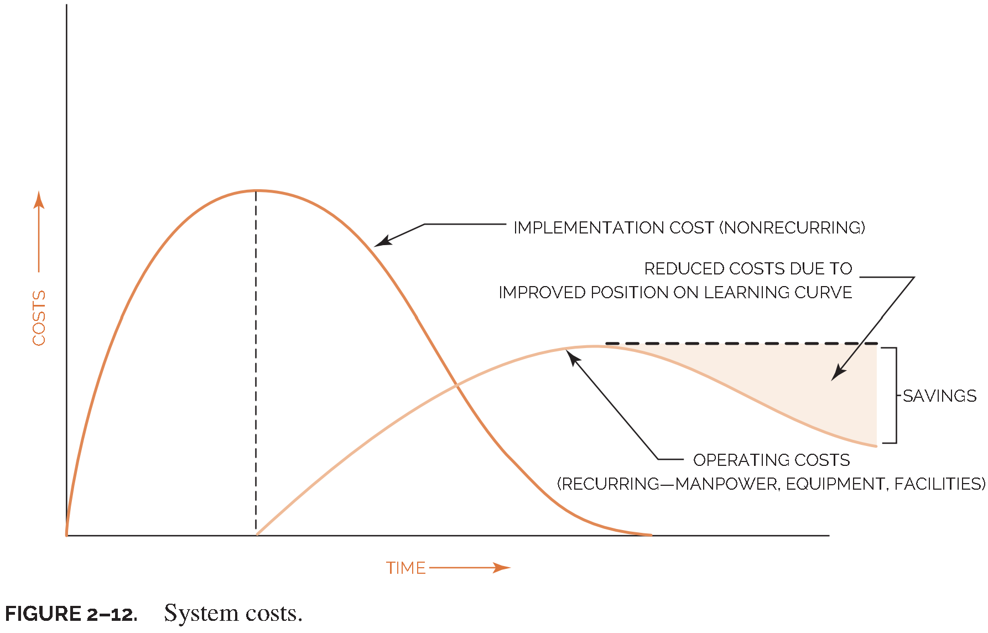
Planning
Source: Kerzner (2017)

Slide 27
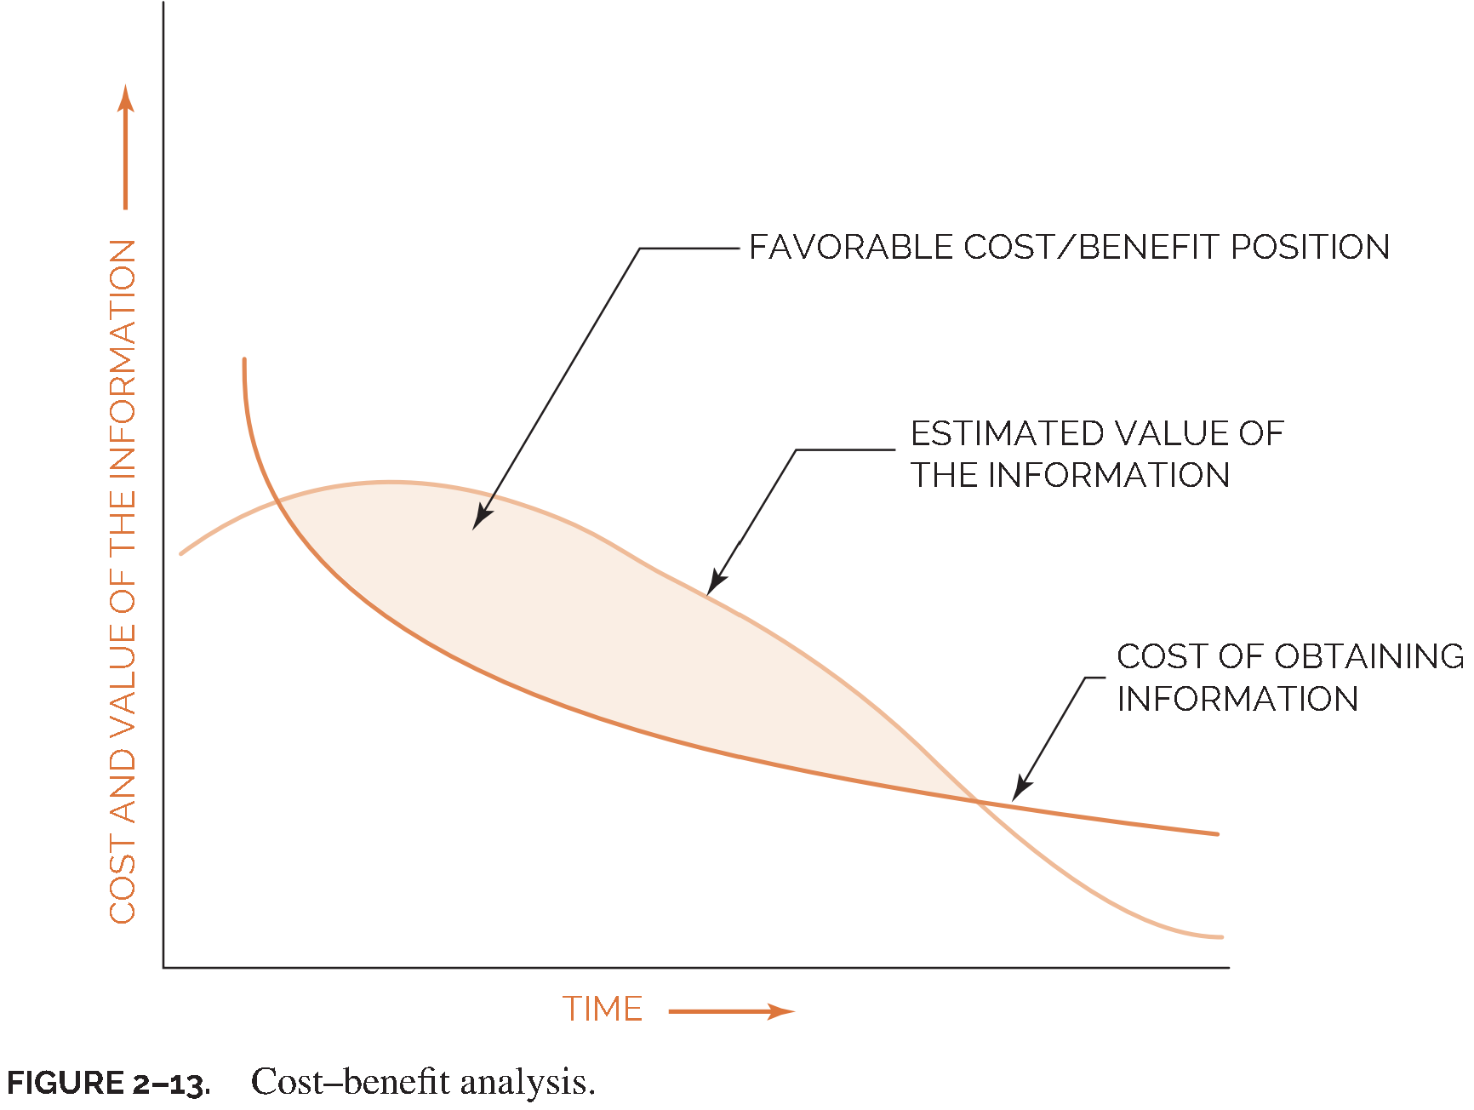
Planning
Source: Kerzner (2017)

Slide 28
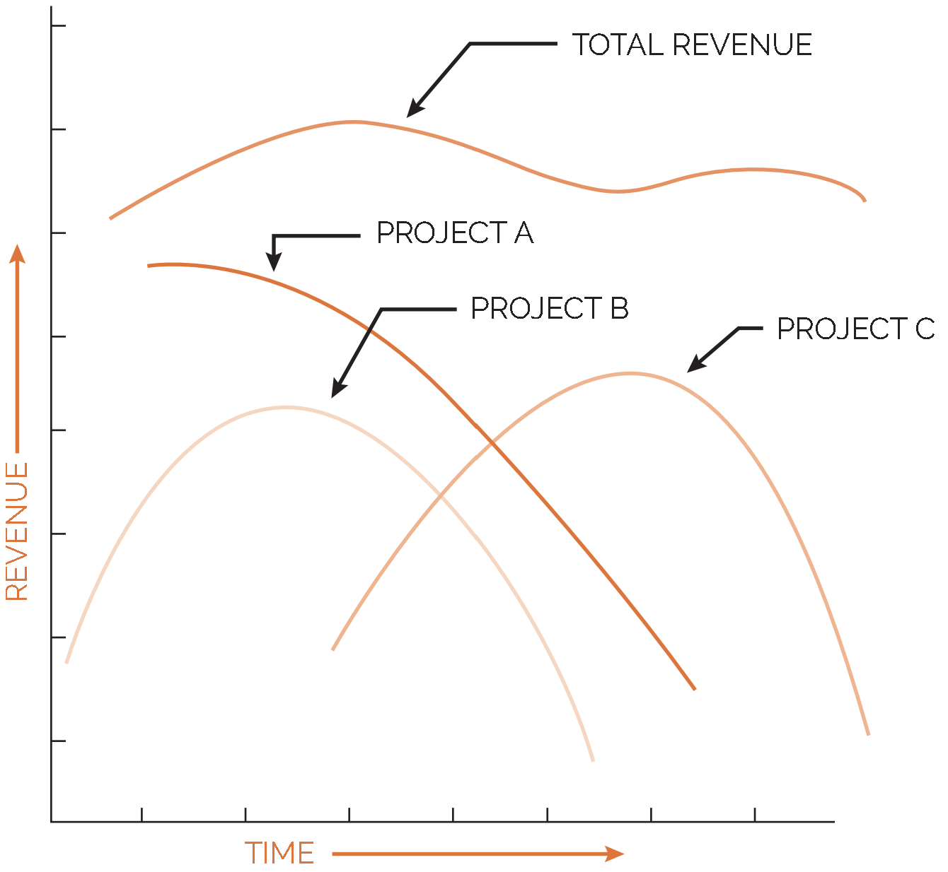
A stream of projects
Source: Kerzner (2017)

Slide 29
Organizational change management and corporate cultures
Successful development and implementation of a project management methodology requires:
Identification of the most common reasons for change in project management
Identification of the ways to overcome the resistance to change
Application of the principles of organizational change management to ensure that the desired project management environment will be created and sustained
Source: Kerzner (2017)

Slide 30
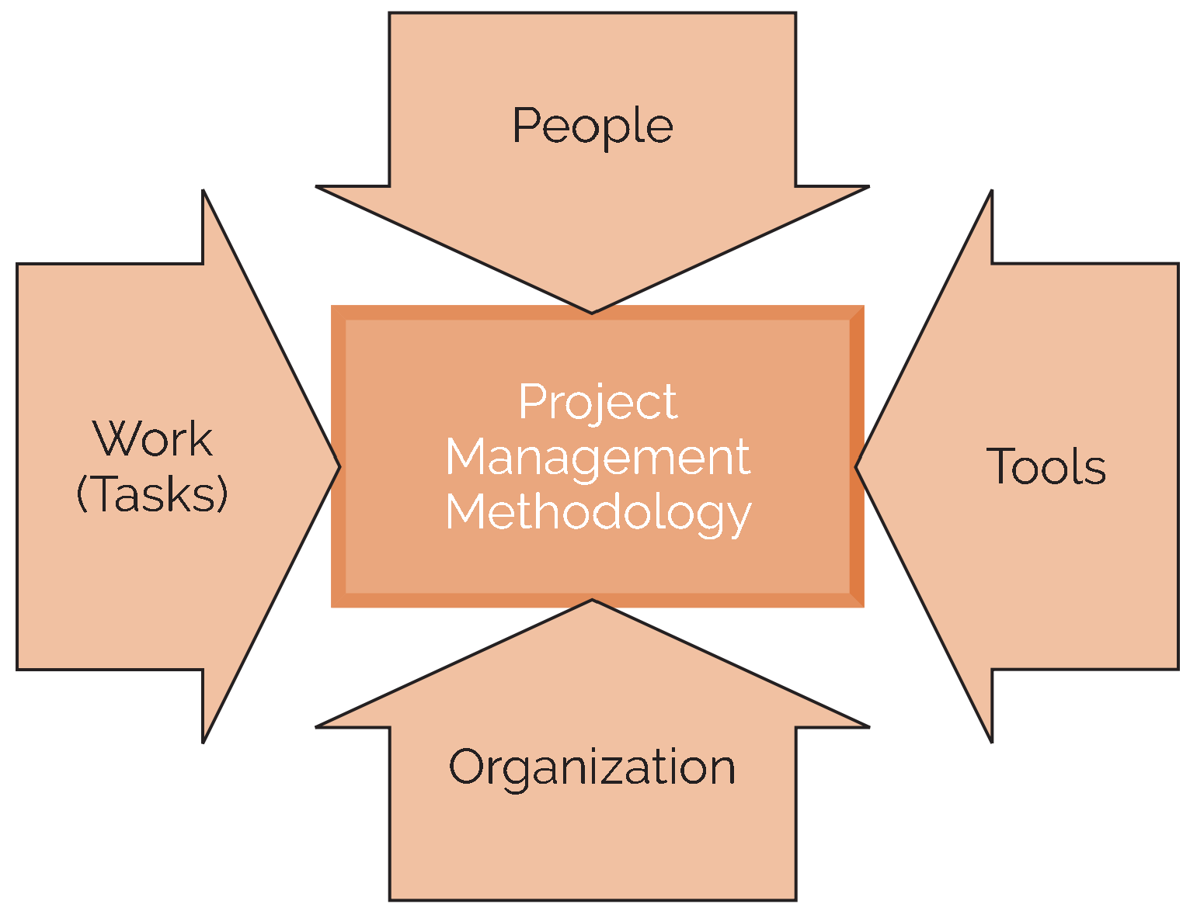
Methodology inputs
Source: Kerzner (2017)

Slide 31
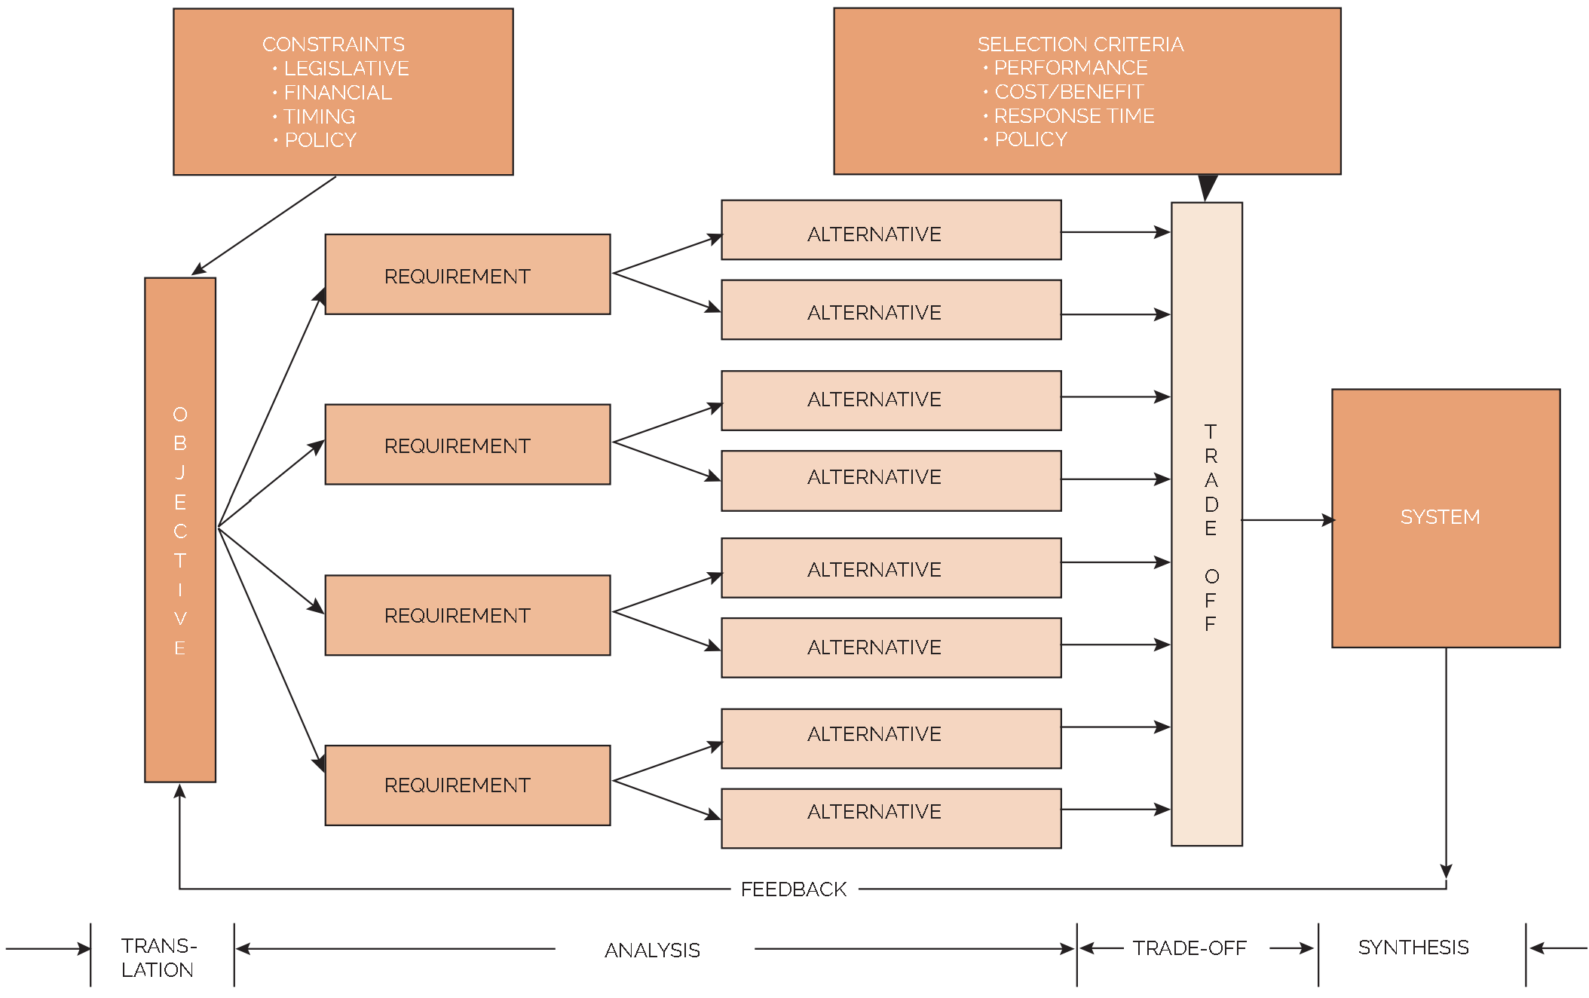
Systems thinking
Source: Kerzner (2017)

Slide 32
Project Delivery Principles
These principles “are built around a set of statements that guide the actions and behaviors of project management practitioners regardless of development approach.”
Stewardship
Team
Stakeholders
Value
Holistic Thinking
Quality
Complexity
Leadership
Tailoring
Opportunities and Threats
Adaptability and Resilience
Change Management
Source: Heagney (2022)

Slide 33
Performance Domain
Groups of related activities that are critical for the effective delivery of project outcomes.
Team
Stakeholders
Life Cycle
Planning
Navigating Uncertainty and Ambiguity
Delivery
Performance
Project Work
Source: Heagney (2022)

Slide 34
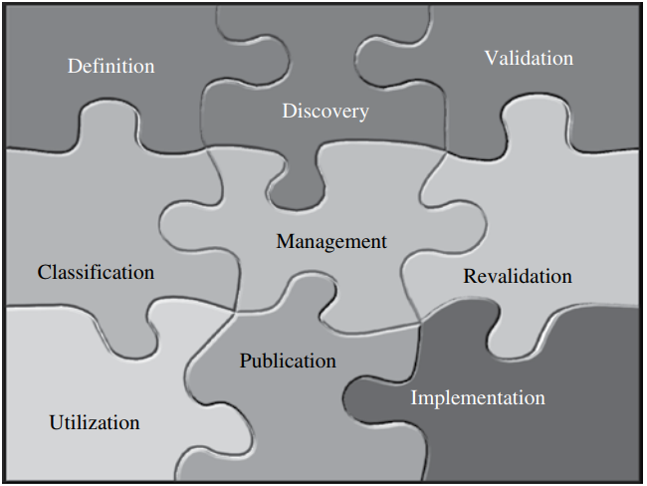
Best practices process
Source: Kerzner (2024)

Slide 35
Best practices process
What is the definition of a best practice?
Who is responsible for identifying the best practices, and where do we look?
How do we validate that something is a best practice?
Are there levels or categories of best practices?
Who is responsible for the administration of the best practice once approved?
How often do we reevaluate whether something is still a best practice?
How do companies use best practices once they are validated?
How do large companies make sure that everyone knows about the existence of the best practices?
How do we make sure that the employees are using the best practices and using them properly?
Source: Kerzner (2024)

Slide 36
1. Step 1: Definition of a best practice
Something that works
Something that works well
Something that works well on a repetitive basis
Something that leads to a competitive advantage
Something that can be identified in a proposal to generate business
Something that differentiates us from our competitors
Something that keeps the company out of trouble and, if trouble occurs, the best practice will assist in getting the company out of trouble
Source: Kerzner (2024)

Slide 37
1. Step 1: Definition of a best practice
To improve efficiency
To improve effectiveness
To achieve standardization
For consistency
Source: Kerzner (2024)

Slide 38
2. Step 2: Seeking out best practices
Project Management institute (PMI) publications
Forms, guidelines, templates, and checklists that can affect the execution of the project
Forms, guidelines, templates, and checklists that can affect the definition of success in a project
Each of the PMBOK® Guide areas of knowledge or domain areas
Within company-wide or isolated business units
Seminars and symposiums on general project management concepts
Seminars and symposiums specializing in project management best practices● relationships with other professional societies
Graduate-level theses
Source: Kerzner (2024)

Slide 39
3. Step 3: Validating the best practice
Is transferable to many projects
Enables efficient and effective performance that can be measured (i.e., can serve as a metric)
Enables measurement of possible profitability using the best practice
Allows an activity to be completed in less time and at a lower cost
Adds value to both the company and the clients
Can differentiate us from everyone else
Source: Kerzner (2024)

Slide 40
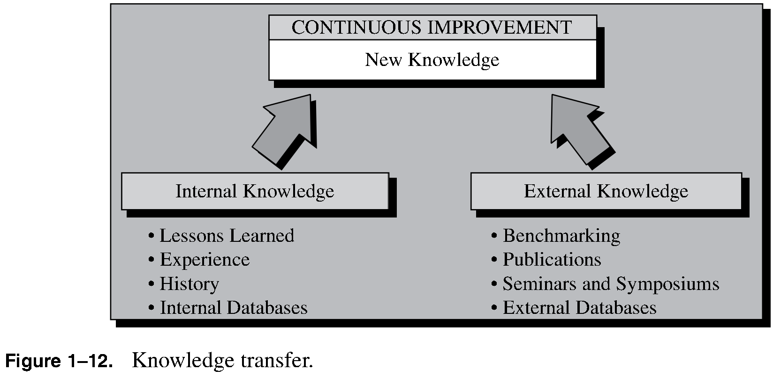
4. Step 4: Levels of best practices
Source: Kerzner (2024)

Slide 41
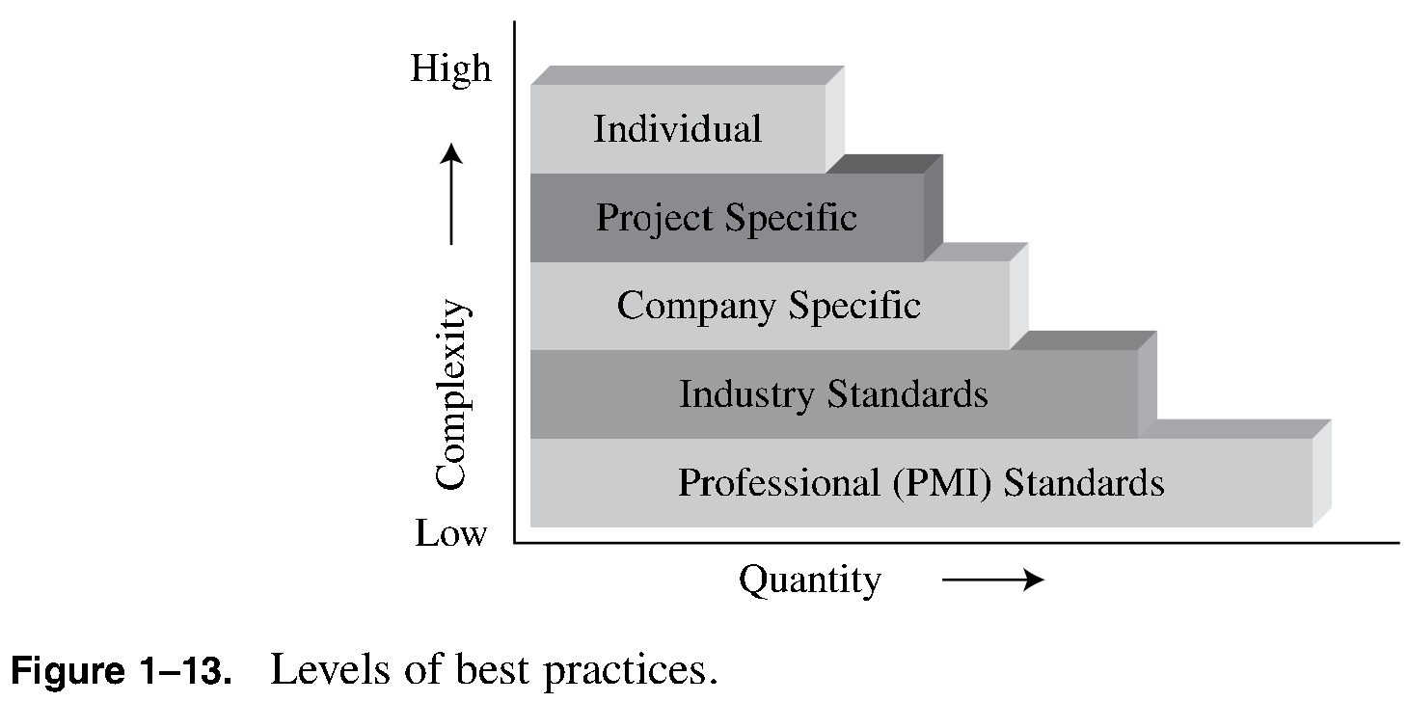
4. Step 4: Levels of best practices
Source: Kerzner (2024)

Slide 42
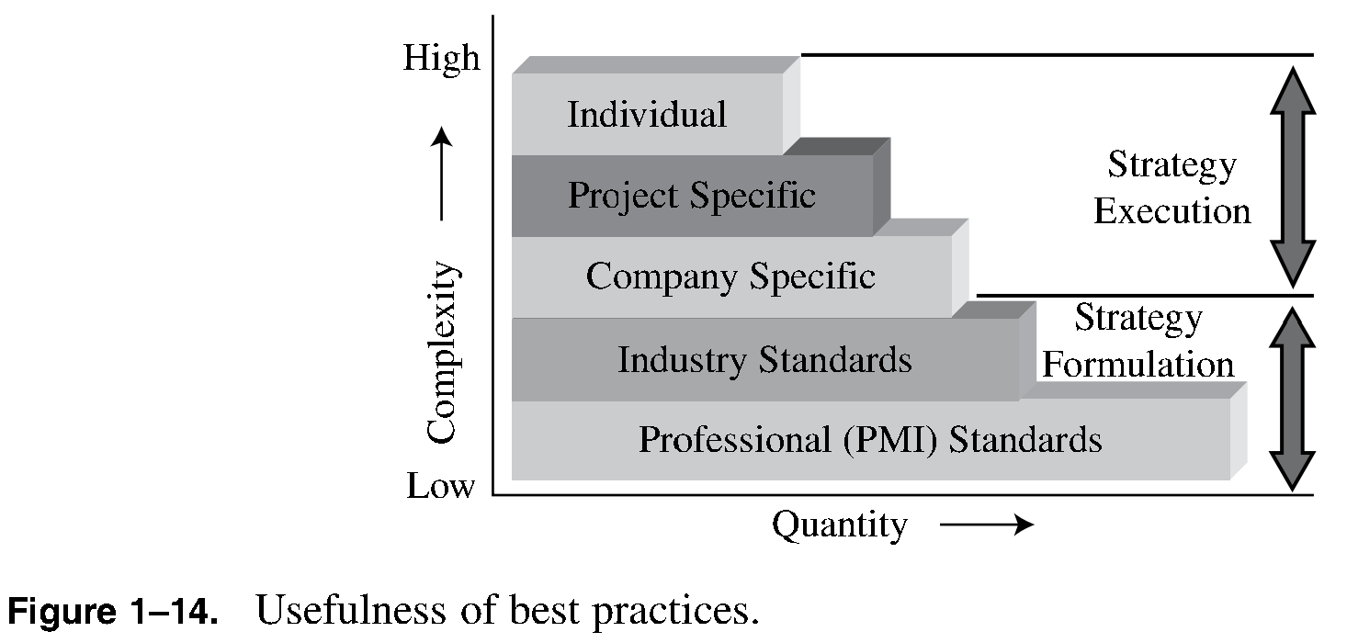
4. Step 4: Levels of best practices
Source: Kerzner (2024)

Slide 43
5. Step 5: Management of best practices
There are three players involved in the management of the best practices:
The best practice’s owner
The PMO
The best practices’ library administrator, who may reside in the PMO
Source: Kerzner (2024)

Slide 44
6. Step 6: Revalidating best practices
There are usually three types of decisions that can be made during the review process:
Keep the best practice as is until the next review process.
Update the best practice and continue using it until the next review process.
Retire the best practice from service.
Source: Kerzner (2024)

Slide 45
7. Step 7: What to do with a best practice
The most common options available include:
Sharing knowledge internally only.
Hidden from all but a select few.
Advertise to the company’s customers.
Source: Kerzner (2024)

Slide 46
8. Step 8: Communicating best practices across the company
Some of the techniques include:
Websites
Best practices libraries
Community of practice
Newsletters
E-mailings
Internal seminars
Transferring people
Case studies
Other techniques
Source: Kerzner (2024)

Slide 47
9. Step 9: Ensuring usage of the best practices
Maintaining a best practices library is an excellent way of determining workers’ interest in the best practices.
When best practices are used as competitive weapons and advertised to potential customers as part of competitive bidding, the marketing and sales force must understand the best practices and explain this usage to the customers.
Source: Kerzner (2024)

